Slide 1
ELE PowerPoint Template
This template was updated and revised September 2023
Contains the following sections:
Sample engagement slides for interactive activities

Slide 2
Session Title
Executive Learning Exchange
Chicago, IL

Slide 3
HELPING LEARNING LEADERS GROW
COMMUNITY
GET FRESH IDEAS
COLLABORATE
BUILD NEW SKILLS
BUSINESS IMPACT
Connect with trusted learner leaders
NEXT practices, beyond best practices
You don't need to solve everything yourself
Share experiences with your peers
Create a future ready workforce
Notes:
b

Slide 4
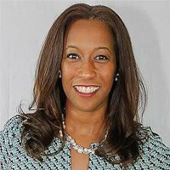
Iris Wilson-Farley
VP, Talent
Komatsu
Denise Banks
CHRO
Art Institute of Chicago
The opinions and views expressed are my own and do not represent the views of my employer

Slide 5
Meet Your Presenters
Name
Name
Name
Name
Name
Company Name
Company Name
Company Name
Company Name
Company Name

Slide 13
Thank You

Slide 14
Sample Engagement Activities

Slide 15
Process Flow Example
Title
Title
Title
Title
Title
Title
Title
TITLE
TITLE
TITLE
Title
Title
Title
Title
Title
Title
Title

Slide 16
Activity
Expertise of platform
Multitasking
Creativity
What do you consider your best quality as a Producer?
Choose one and type your initials on the corresponding sticky note.
Flexible
Attention to detail
Troubleshooting
Notes:
2 MIN

Slide 17
1-on-1 Chat Activity
Working with your partner, discuss via private chat, what kind of transportation you use. Names in bold will initiate chat.
Dirk & Wendi | Elyse & Phillipe
Azizeh & Joel | Bill & Carl
Anne & Stephen | Yan & David
Tashonda & Marcus | Shane & Jessica
Jose and Diava | Patti & Keith
Find your partner and say privately say “hello” to one another in your chat window

Slide 18
Complete the Sentence
A great leader is________________________?
Complete the sentence.

Slide 19
Discussion Activity
Share your response.
What are ways to demonstrate gratitude to an employee?

Slide 20
Annotation Activity Using Last Names
Last Names beginning with A - M
Last Names beginning with N - Z
When is it appropriate to turn off your webcam?
When would I need to keep it on?
Have participants use the text annotation tool to enter their responses in the column that corresponds with their last name.

Slide 21
Tool Example
ENGAGEMENT | USING BREAKOUT ROOMS | AUDIO ISSUES
HANDELING TECHNICAL ISSUES | WHITEBOARD | WEBCAM ISSUES
KNOWLEDGE OF PLATFORM TOOLS | POLLING | BEING ABLE TO MULTITASK
Using the annotation stamp tool, enter a check mark or x in the boxes that you are most anxious about.

Slide 22
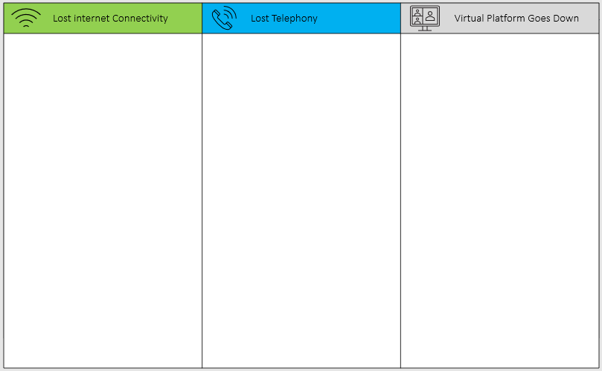
CONTIGENCY PLAN ACTIVITY
Think about possible solutions and contingencies for these three areas and enter your responses under the column header.
3 minutes
Notes:
To prepare for our next activity, we will be sharing a three column Annotation Grid.
I would like you to begin thinking about solutions and develop a list of possible contingencies for any of these three areas.
On your Annotation Toolbar, select Format and change the Font to 12 point
Select the Text tool, Click inside any one of the three columns
Resize your text box to fit the column width
Type your solution
ASK Does anyone have any questions?

Slide 23
Lost Internet Connectivity
Lost Telephony
Virtual Platform Goes Down

Slide 24
Knowledge Check
Instructions: Read each statement and match it with the critical thinking mistake it illustrates and enter your responses i.e. 1a, 2b, 3c, 4d
1. “Are you crazy? That’s the worst idea I’ve heard in a long time.” | a. Rationalization
2. “That’s the way we’ve always done it.” | b. Emotional Thinking
3. “She might not be the most qualified candidate, but she could start working right away and it’s such a hassle to keep looking for another candidate.” | c. Bias
4. “George told me this provider is great and he’s always right.” | d. Tunnel Vision

Slide 25
Fact or Opinion
Instructions: Read each statement and determine whether the statement is a fact or an opinion.
Police arrested three burglars last night.
He has the most clout in the organization.
She said the CEO was the smartest businessperson she had ever known.
Highlight Fact or Opinion.

